Slide 1
Proposed Motor Claims Administration System for ComfortDelGro – screen dumps of current versions
Prepared by –
Yip Cheng Choon, VP-EbixExchange Asia
Feb 2014

Slide 2
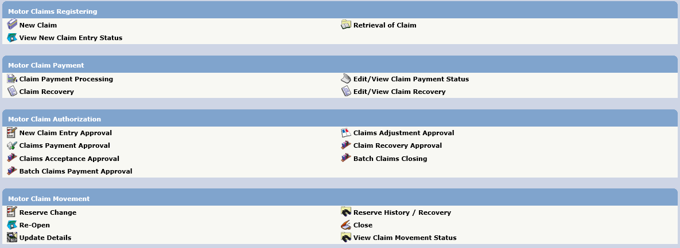
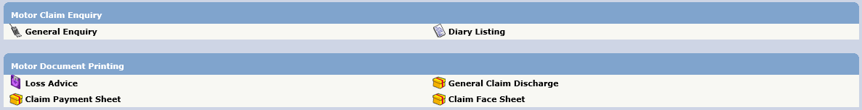
Motor Claims Module

Slide 3
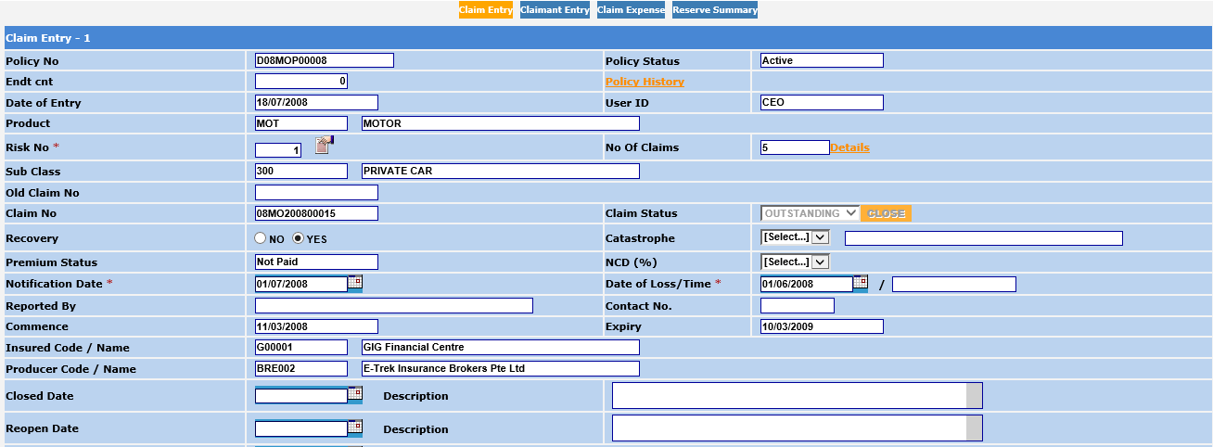

Slide 4
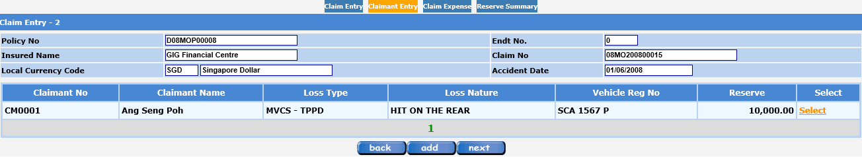
Claims Registration – Accident Details

Slide 5
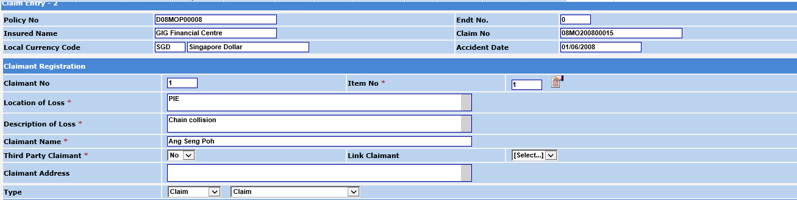
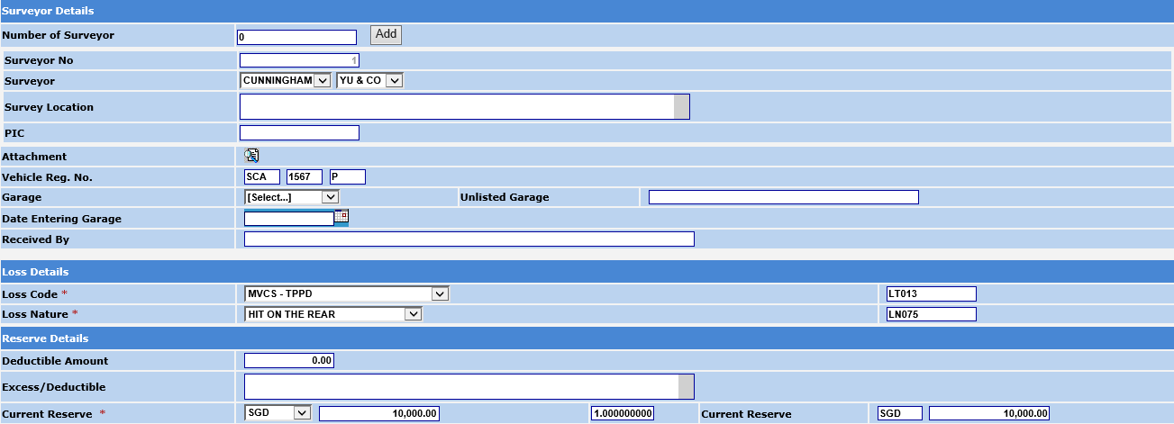
Claims Registration – Accident Details - 2

Slide 6
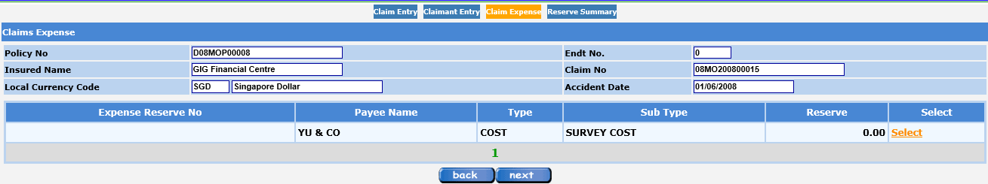
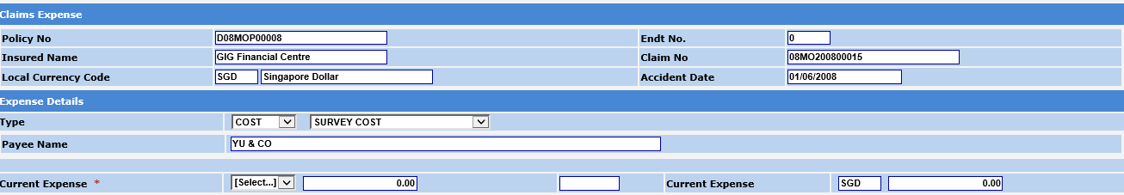
Claims Registration – Expenses Details - 1

Slide 7
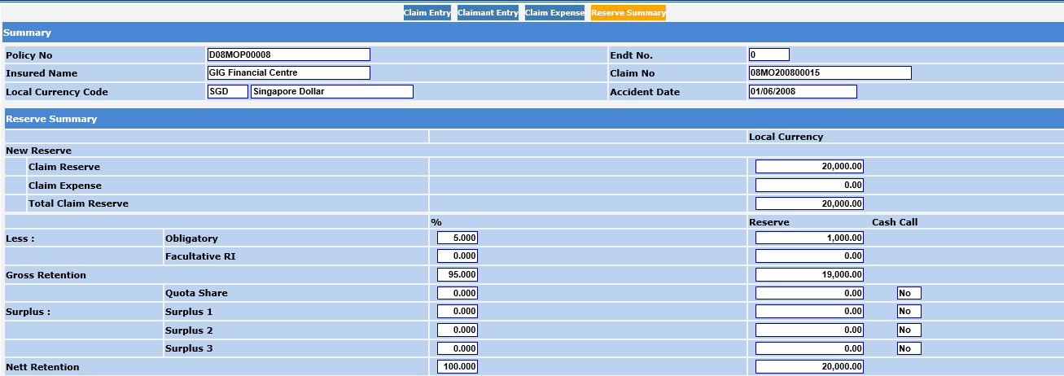
Claims Registration – Reserve Summary

Slide 8
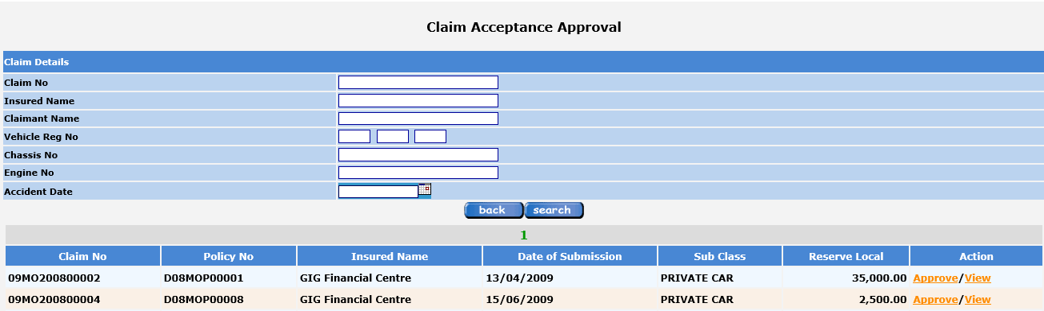
Claims Approval screen for – Registrations, Adjustments, Payments and Recoveries
Same screen layout where Approver can view the details before clicking on “Approve” text in Action column.

Slide 9
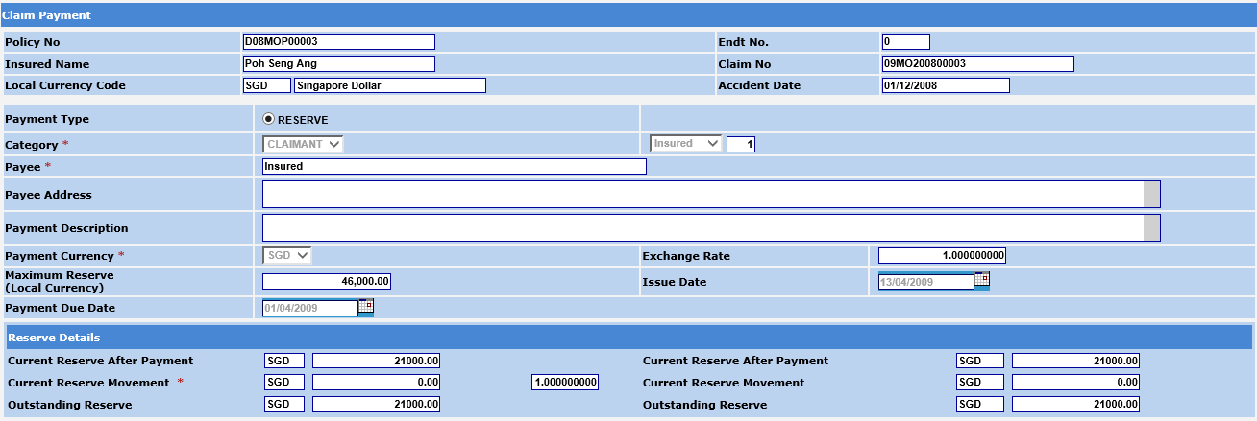
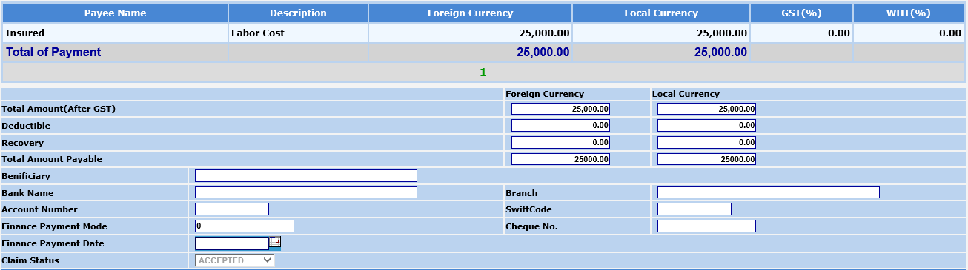
Claims Payment

Slide 10
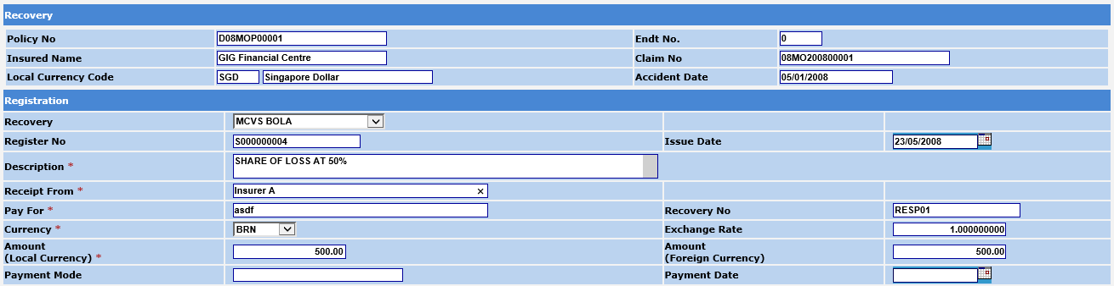
Claims Recovery

Slide 11
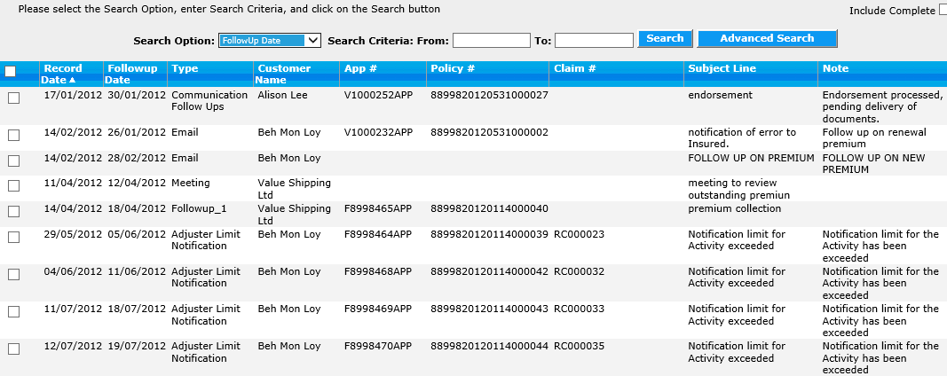
Claims Diary Tracking and Workflow – new feature to include

Slide 12
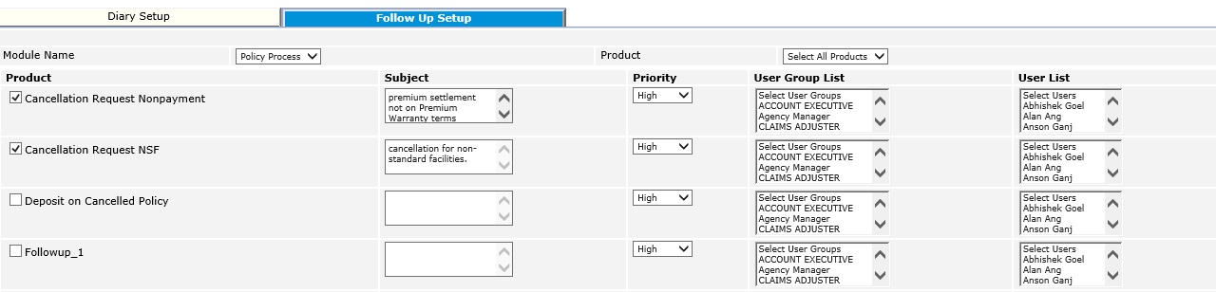
Claims workflow – assignment and allocation set up

Slide 13
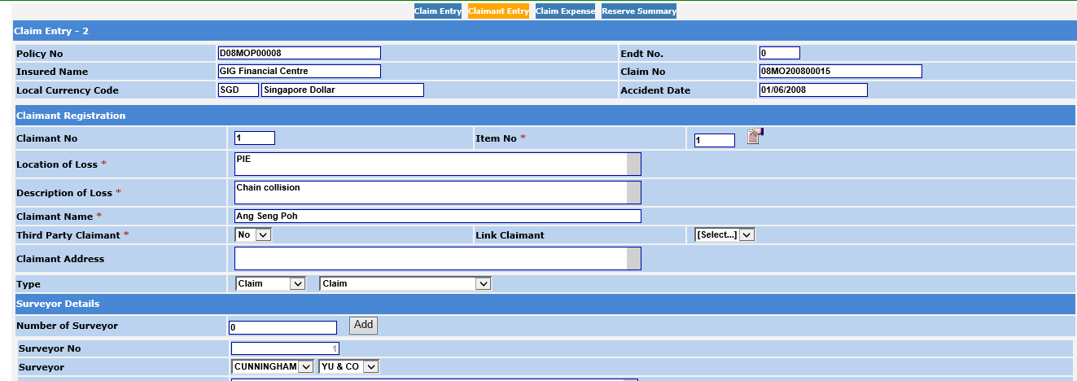
Claims Admin – New tabs to segregate data between Third Party and OD data
Third Party
OD
Attachments
New Tabs
Reserve Summary – All Claimants

